Slide 1
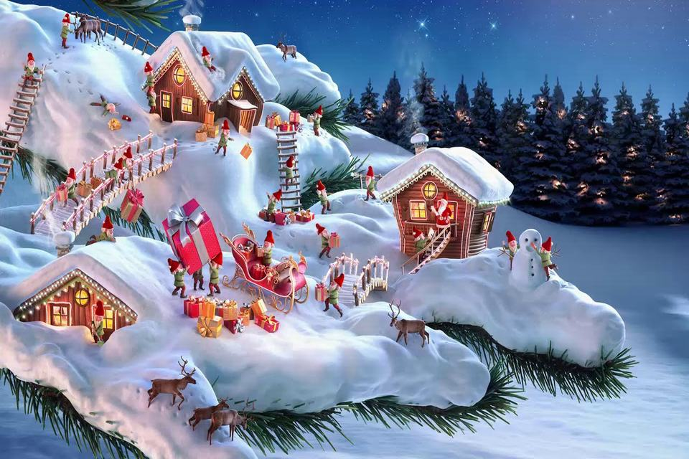
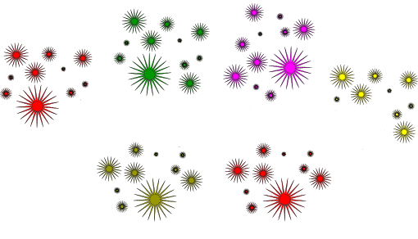
KHUONG MAI SECONDARY SCHOOL
WELCOME TO OUR CLASS 9A2

Slide 2
KIM’S GAME

Slide 3
KIM’S GAME

Slide 4
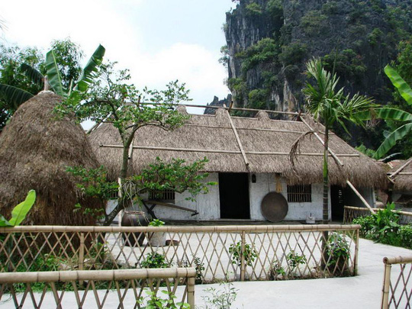
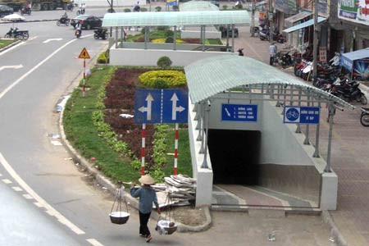
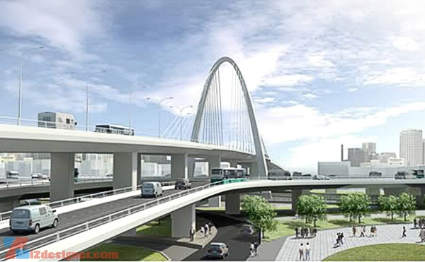
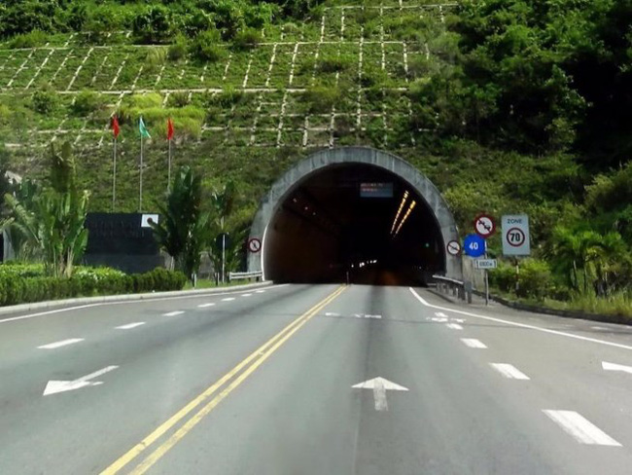
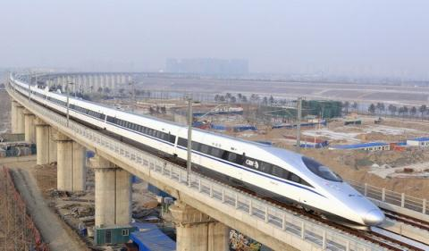
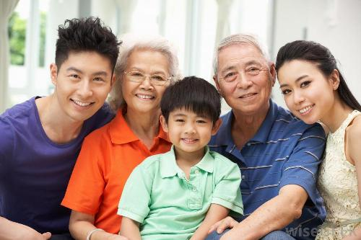
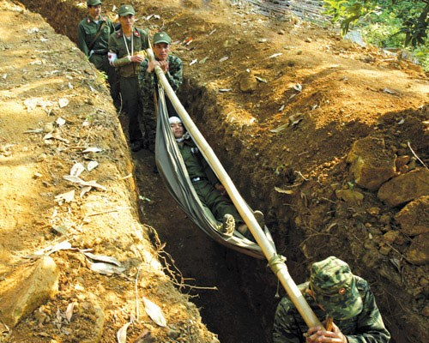
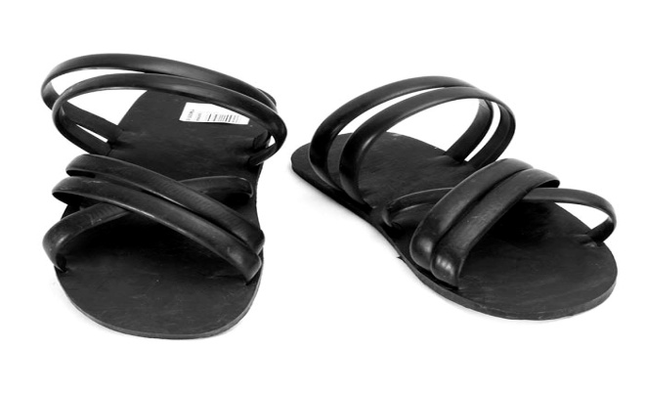
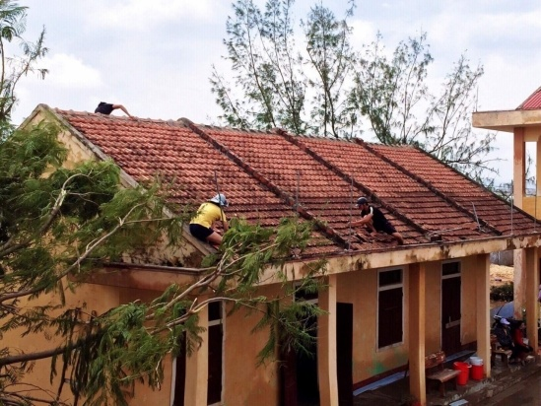
SUGGESTED ANSWERS

Slide 5
KIM’S GAME

Slide 6
SUGGESTED ANSWERS
Thatched house
Underpass
Flyover
Tunnel
Skytrain
Extended family
Trench
Rubber sandals
Tiled roof

Slide 7
PERIOD 53: REVISON

Slide 8
1.vocabulary

Slide 9
Complete the following sentences with the right form of word/ phrases from the box.
trenches facilities uniform thatched house
1. Fifty years ago, we had very few schools and the rows of classrooms looked like……………….
thatched house.
2. During wartime, all around the rows of classrooms there were………………..so that children could shelter from bombs.
trenches
3. Modern classrooms are well equipped with the
various ………………. Including bookshelves,
cassettes players or computers.
facilities
4. In the past, school children didn’t often wear …………….. like they do to day.
uniform

Slide 10
2. grammar

Slide 11
Before 10 a.m yesterday
What had they done before 10 a.m yesterday?
They had read books.

Slide 12
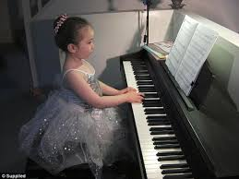
What had she done before she went out?
She had played the piano.

Slide 13
PAST perfect
They had read books before 10 a.m yesterday
She had played the piano before she went out.
FORM: S + HAD ( NOT)+ V ( PII) …….
HAD + S + V ( PII) ……………..?
WH + HAD + S + V ( PII) ……. ?

Slide 14
Using past perfect tense to write sentences
1.They/ repaint/ house/ before / 8a.m last Monday.
=> They had repainted their house before 8a.m last Monday.
2. Students / go out / before / I / come.
=> Students had gone out before I came in.
3. Before 1990s/ my dad / live /Ha Noi.
=> Before 1990s my dad had lived in Ha Noi.
4. My mom / go/ work / after / I / get up.
=> My mom went to work after I had gotten up.
5. People/travel / bike / before / motorbike / be/ imported.
=> People had travelled by bikes before motorbike was imported.

Slide 15
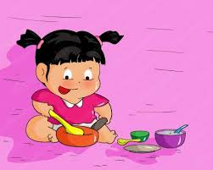
LOOK AT THE PICTURE, WORK IN PAIR, ASK AND ANSWER
Before 7:30 yesterday evening
A: What had she done before 7:30 yesterday evening?
B: She had eaten dinner.

Slide 16
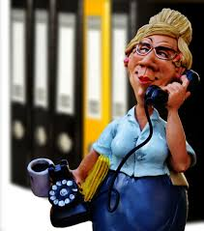
Before 8 a.m last Monday

Slide 17
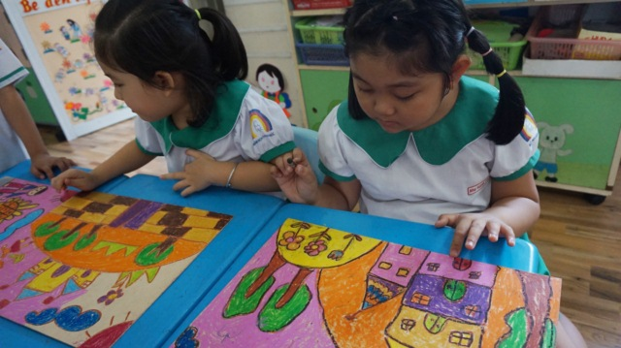
Before learning math

Slide 18
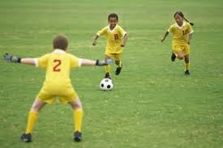
Before they went home

Slide 19
Before she went to work

Slide 20
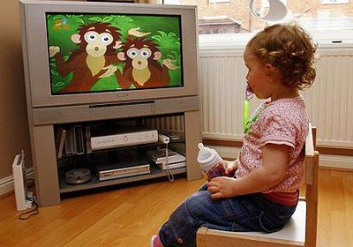
Before she went to bed

Slide 21
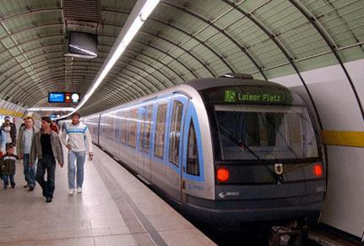
LUCKY STORY

Slide 22
LUCKY ANIMAL

Slide 23
Put the correct form of verb .
They ( study)……..………… before they watched TV.
had studied

Slide 24
Choose a word to fill in the gap.
extended nuclear rich
She didn’t have much private because she lived in ………… family.
extended

Slide 25
Choose a word to fill in the gap.
High living entertain themselves tradition
Children in my time used to ……………………… by playing with things they could find in nature.
entertain themselves

Slide 26
Choose a word to fill in the gap.
respect for seniority an acceptance tram
Most Asian countries place a great value on………………….
respect for seniority

Slide 27
Choose a word to fill in the gap.
generous gentle obey
It’s a tradition in Viet Nam that the juniors have to ……… the seniors.
obey

Slide 28
3. speaking

Slide 29
WORK IN GROUP
Group 1, 2
Group 3,4
Talk about the changes of school life in the past and now.
Talk about the changes of transport system in the past and at the present.

Slide 30
WHAT SHOULD WE DO TO IMPROVE THE LIVING STANDARD ?
WE
HAVE TO PROTECT WHAT WE HAVE
WE
SHOULD DO THE USEFUL THINGS
WE HAVE TO STUDY HARD

Slide 31
HOMEWORK
LEARN MORE NEWWORDS
STUDY AND TRY TO REMEMBER STRUCTURE:PAST CONTINUOUS
READING MORE BOOKS

Slide 32
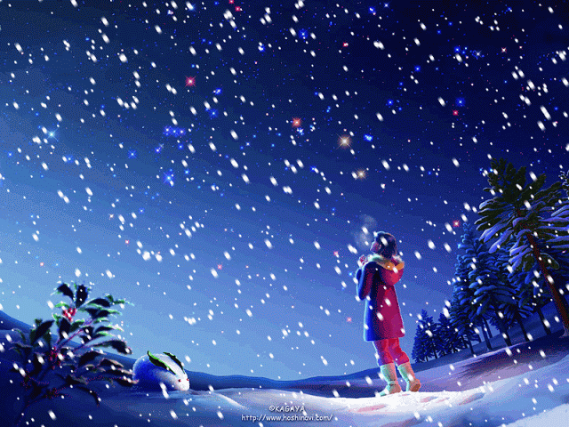
Thank for attending ours!
Good bye for now!

